Slide 1



CALPADS
EOY Primer
Preparation for the End of Year data Collection

Slide 2




Objective
Identify
Submit
Provide
Take
the key dates, milestones and timeline of the End of Year Submissions
Project Management
data in advance of the data collection window through an understanding of operational keys and processing methods
Manage & Maintain Data
information using report data early in the submission window to encourage investment and cooperation during the EOY Data collection
Coalition Building
advantage of the training resources to educate staff of requirements and functionality
Critical Thinking
EOY Primer v1.0 AY 2023-24

Slide 3







Agenda
EOY Overview
EOY 1
EOY 2
EOY 3
EOY 4
Wrap-Up

Slide 4


EOY Overview
Discuss background of EOY submissions
EOY Primer v1.0 AY 2023-24

Slide 5
EOY Data Collections
EOY 3
July 1–June 30
Student Behavioral Incidents
Course completion
EOY 1
July 1–June 30
Grades 7-12
EOY 2
July 1–June 30
Program
Participation
CTE participants and completers (Perkins Report)
Student Absence Summary
EOY 4
July 1–June 30
SWD Status
SWD Services
(Not Collected AY23-24)
PSTS for SPED
Homeless Program
Carnegie Units
College Credit
Work-Based Learning
Cumulative Enrollment
RFEP
Grads and Completers
Leadership/Military Science
SWD Meetings
SWD Plans
EOY Primer v1.0 AY 2023-24

Slide 6

Quick Reminders
EOY Snapshots Begin
May 7, 2024
EOY Primer v1.0 AY 2023-24

Slide 7
Data Collection Window for 2023-24
Census Day
Certification Deadline
Final Deadline
Oct 4, 2023
Dec 15, 2023
January 26, 2024
ODS Cohort Pull
August 15, 2024
Amendment
Fall 1 Submission
Cohort Processing - ongoing
Nov
Dec
Jan
Feb
Apr
May
Jun
Jul
Aug
Sep
2023
Oct
Mar
Fall 2 Submission
EOY Submissions
Submit Fall 2 Data
Amendment
Fall 2 Deadline
Start of Submission
March 15, 2024
May 7, 2024
Certification Deadline
Final Deadline
July 26, 2024
August 16, 2024
https://www.cde.ca.gov/ds/sp/cl/rptcalendar.asp
EOY Primer v1.0 AY 2023-24

Slide 8
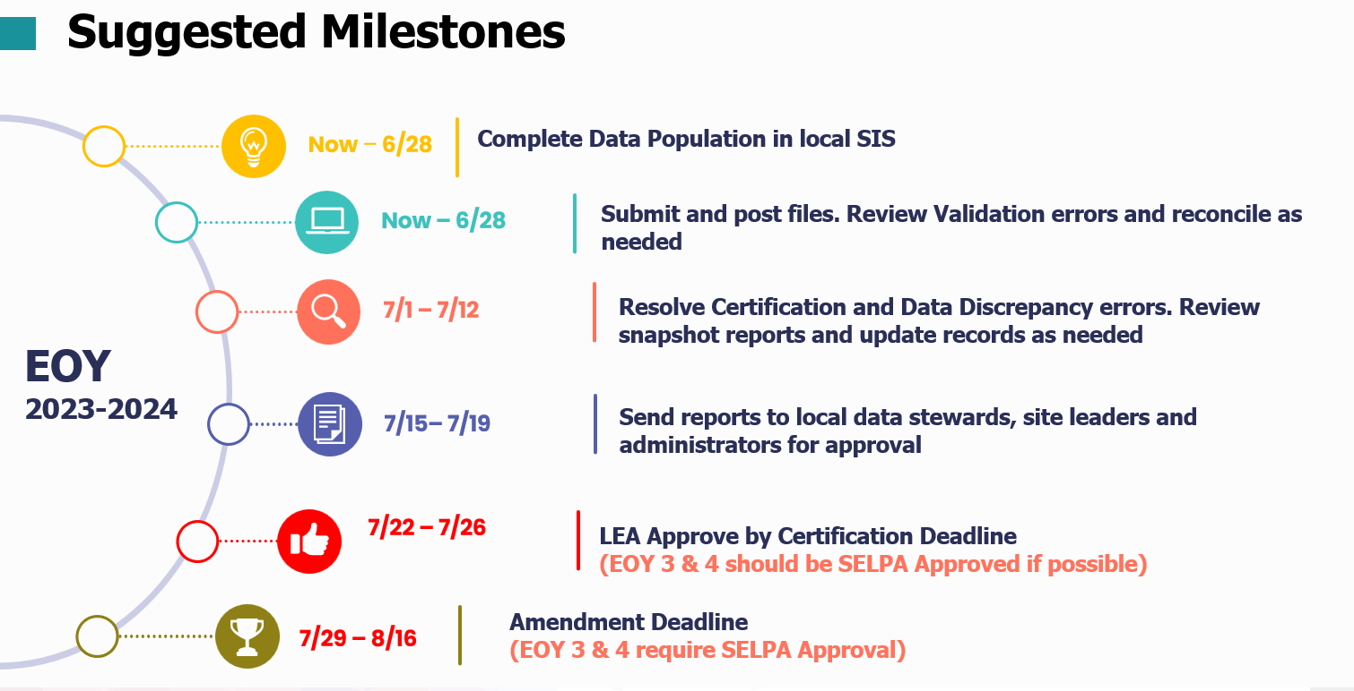



Suggested Milestones
Now – 5/8
Complete Data Population in local SIS
Now – 6/23
Submit and post files. Review Validation errors and reconcile as needed
6/26 – 7/14
Resolve certification errors. Review snapshot reports and update records as needed
EOY
2022-2023
7/17– 7/21
Send reports to local data stewards, site leaders and administrators for approval
7/24 – 7/28
Certify by Initial Deadline
Amendment and Final Deadline
(EOY 3 & 4 require SELPA Approval)
7/29 – 8/25
EOY Primer v1.0 AY 2023-24

Slide 9
Certification Process
EOY 1 & 2 has ONE level of approval
EOY 3 & 4 have TWO levels of approval
EOY Primer v1.0 AY 2023-24

Slide 10
CALPADS User Manual
EOY Reporting Roadmap
EOY Primer v1.0 AY 2023-24
Notes:
Documentation.calpads.org

Slide 11

EOY 1
Course Completion, Career Technical Education, Work-based Learning preparation
EOY Primer v1.0 AY 2023-24

Slide 12
EOY 1 Data Collection
Data Submitted
Student Enrollment (SENR)
Files Submitted
Course Completion (CRSC)
Student Crs. Completion (SCSC)
Student CTE (SCTE)
Work-based Learning (WBLR)
Staff Demographics (SDEM)
Career Technical Education
Work Based learning
Course Completion
Perkins
CCI
CCI
Perkins
CCI
Site Staff
Staff Involved with Submission
Registrars
Program staff
CTE
Site Administrators
Student System Support Staff
EOY Primer v1.0 AY 2023-24

Slide 13
EOY 1 Pre-snapshot Submission Activities
Record Type | Activity | Reasoning | Processing Method | Record Operation Keys
SENR | Ongoing | Enrollment records should be updated with student movement | Transaction | School of Attendance SSID Enrollment Start Date
SDEM | Now | Teachers already in master schedule and assigned to courses | Transaction | Reporting LEA SEID
CRSC | Now | Course records for entire AY in master schedule | Replacement | School of Course Delivery Academic Year ID Academic Term Code
SCSC | Submit all completed grading periods* | Students have or nearly completed ¾ quarters, 1 of 2 semesters 2/3 trimesters GRADES are Available Now | replacement | SSID School of Course Delivery Academic Year ID Academic Term Code Marking Period Code (For SCSC ONLY)
WBLR | Can Submit a test file | Likely that students are still earning WBLR hours | Replacement | School of Attendance Academic Year ID
EOY Primer v1.0 AY 2023-24

Slide 14
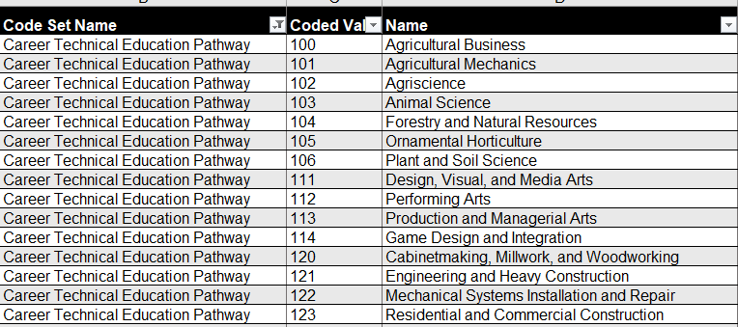
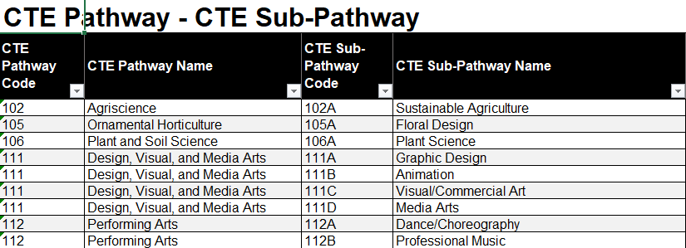
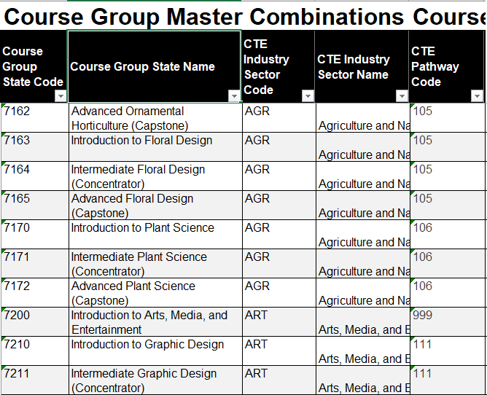
Pain Points
CTE Pathway Mapping
CERT123
At least one SCSC record with a Course Section ID at the same Reporting LEA for the student that is mapped to a CRS-State Course Code in a CRSC record that can then be mapped to the CTE Pathway specified for the student in the SCTE file and the SCSC record must have a Capstone Course Indicator = Yes.
EOY Primer v1.0 AY 2023-24

Slide 15
EOY 1 Reports
Course Completion
CTE
Work Based Learning
Report 3.9
Report 3.10
Report 3.11
Course Sections Completed – Count by Content Area for Departmentalized Courses
Course Sections Completed – Count and Details for Departmentalized Courses
Course Sections Completed – Student List for Departmentalized Courses
Report 3.16
Educational Options Course Completion – Student Count
Report 3.14
Report 3.15
  Career Technical Education Noncompleter Participants - Count
  Career Technical Education Noncompleter Participants– Student List
Legend
Aggregate Report
Supporting Report
Report 3.19
Report 3.20
  Career Technical Education Completers – Count by Pathway
  Career Technical Education Completers– Student List
Report 18.1
Report 18.2
  Work-Based Learning -Count
  Work-Based Learning – Student List
EOY Primer v1.0 AY 2023-24
Notes:
EOY 1 Data Mapping Guides in the user manual -- https://documentation.calpads.org/Reports/SnapshotODSReports/#eoy-1-report-mapping-guides.

Slide 16
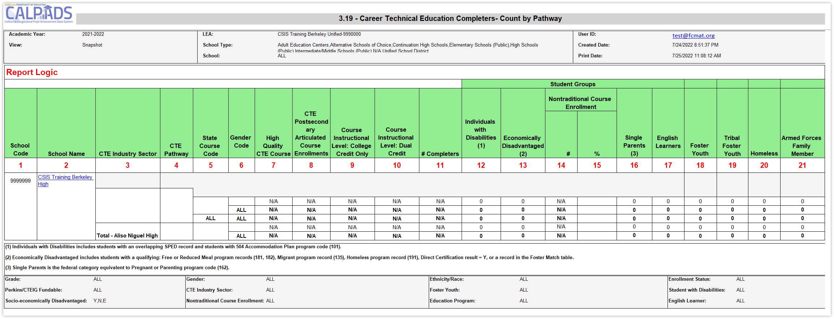
Identify Completers or Misaligned Pathways
Submit SCSC and SCTE files to estimate completer counts prior to EOY
EOY Primer v1.0 AY 2023-24

Slide 17
Available EOY 1 Training
Other Information
CALPADS Update FLASH #174 (SWD WBLR)
CALPADS Update FLASH #183 (CTE & WBLR)
CALPADS Update FLASH #184 (WBLR)
CALPADS Update Flash #229 (WBLR)
SCTE FAQ
CTE FAQ
Course Completion FAQ
CALPADS User Manual
EOY Road Map
Staff Demographics
Student Course Section
Student Career Technical Education
Work-based Learning
CSIS YouTube Training Channel
End of Year (EOY) Data Population Trainings
End of Year (EOY) Reporting & Certification Trainings
EOY Primer v1.0 AY 2023-24

Slide 18

EOY 2
Program Participation preparation
EOY Primer v1.0 AY 2023-24

Slide 19
EOY 2 Data Collection
Files Submitted
STUDENT PROGRAM (SPRG)
Program
CARS
Student subgroups
Schoolwide programs
Data
Submitted
External Data
SCHOOLWIDE PROGRAM
Site Staff
Program staff
Site Administrators
Student System Support Staff
Staff Involved with Submission
EOY Primer v1.0 AY 2023-24

Slide 20
EOY 2 Pre-snapshot Submission Activities
Record Type | Activity | Reasoning | Processing Method | Record Operational Keys
SPRG | Ongoing | Program data should be updated as students start and end participation with a particular school. Most records should have been submitted prior to the EOY submission. Certify the schoolwide status in CARS | Transaction | School of Attendance SSID Education Program Code Education Program Membership Start Date Education Service Academic Year Education Service Code
EOY Primer v1.0 AY 2023-24

Slide 21
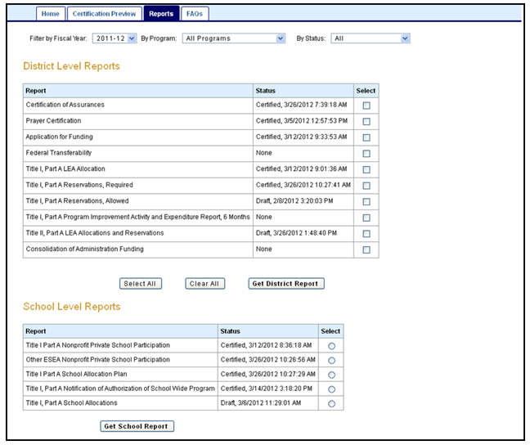
Pain Points
Consolidated Application and Reporting System
A local education agency (LEA) that receives Title I, Part A funds operates one of two programs:
Targeted assistance school (TAS) program,
  Must identify and submit student program records
or
Schoolwide program (SWP)
  Not required to identify individual students or submit records
To be identified in CALPADS, schools operating schoolwide programs must be CERTIFIED in CARS
EOY Primer v1.0 AY 2023-24
Notes:
live demo of website - CARS guidance and updates: https://www.cde.ca.gov/fg/aa/co/cars.asp

Slide 22
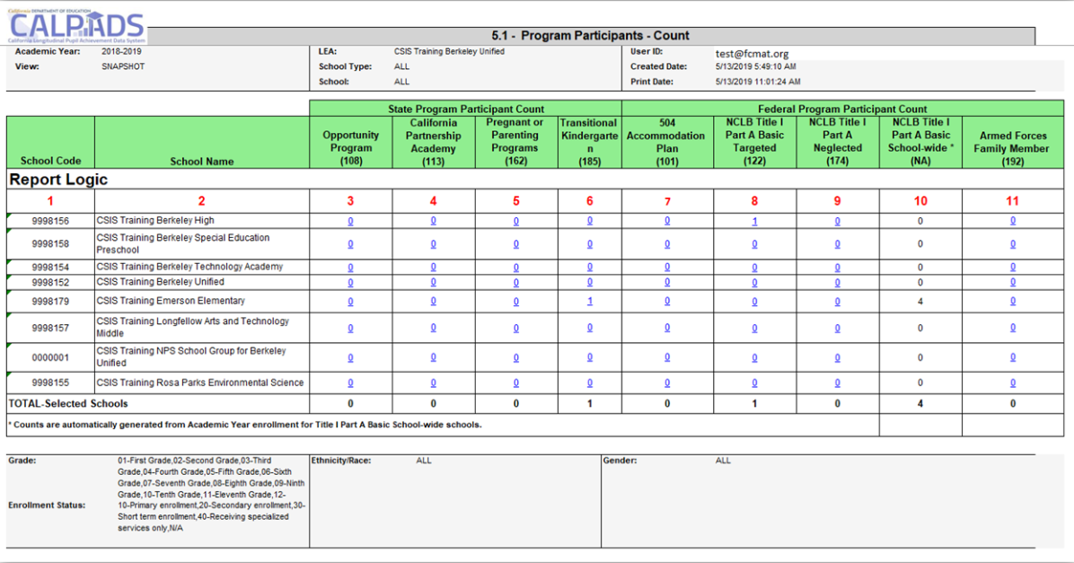
Early Program Counts
EOY Primer v1.0 AY 2023-24

Slide 23
EOY 2 Reports
Program Participation
Report 5.2
Program Participants - NCLB Title I Part A Basic Targeted Education Services
Legend
Aggregate Report
Supporting Report
Report 5.1
Program Participants - Count
Report 5.3
Program Participants - Count
EOY Primer v1.0 AY 2023-24
Notes:
EOY 2 Data Mapping Guides in the user manual -- https://documentation.calpads.org/Reports/SnapshotODSReports/#eoy-1-report-mapping-guides

Slide 24
EOY 2 Training
CALPADS User Manual
EOY Road Map
Student Programs
Other Information
CALPADS Update Flash #228 (TK)
CALPADS Data Guide v11.0
  Section 2.1.3 Student program
CSIS YouTube Training Channel
End of Year (EOY) Reporting & Certification Trainings
Student Program (SPRG) Data Population
EOY Primer v1.0 AY 2023-24

Slide 25

EOY 3
Behavioral Incidents, Absenteeism, Cumulative Enrollment preparation
EOY Primer v1.0 AY 2023-24

Slide 26
EOY 3 Data Collection
Student Incident (SINC)
Data Submitted Via
Student Incident Results (SIRS)
Student Offense (SOFF)
Student Absenteeism (STAS)
Cumulative Enrollment (SENR)
Graduates and Completers (SENR)
RFEP (SELA)
Homeless Program (SPRG)
Incidents
Absence Summary
RFEP
Homeless
Cumulative Enrollment
One Year Grads & Completer
State Indicator
Subgroup data
State indicator
DASS
Suspension Rate
Absenteeism Rate
Subgroup Data
Data Submitted
Site Administrators
Staff Involved with Submission
District Administrators
EL Coordinator
Special Ed staff
Attendance Clerks
Attendance Supervisor
NPS School Staff
EOY Primer v1.0 AY 2023-24

Slide 27
EOY 3 Pre-snapshot Submission Activities
Record Type | Activity | Reasoning | Processing Method | Record Operational Keys
SENR | Ongoing | Enrollments records are used to determine cumulative enrollments and every student should be exited by the end of the AY | Transaction | School of Attendance SSID Enrollment Start Date
SELA | Ongoing | Reclassified EL students should have their status updated withing an enrollment period | Transaction | Effective Start Date SSID
SPRG | Ongoing | Homeless student data should be verified annually and updated when the student is rehoused | Transaction | School of Attendance SSID Education Program Code Education Program Membership Start Date Education Service Academic Year Education Service Code
EOY Primer v1.0 AY 2023-24

Slide 28
EOY 3 Pre-snapshot Submission Activities
Record Type | Activity | Reasoning | Processing Method | Record Operational Keys
STAS | End of Year | Stas is calculated from attendance. Students may need exit dates to extract the data | Replacement | School of Attendance Academic Year ID SSID
SINC | Now | SINC, SIRS and SOFF must be posted in succession and completely, but there is benefit to submitting them prior to school ending to resolve the majority of errors that may arise. Files submission can be completed by school if schools have different end dates or by incident if Q allows for only new incidents to be extracted | Replacement | School of Attendance Academic Year ID Incident ID Local
SIRS | Now |  | Replacement | School of Attendance Academic Year ID Incident Local ID
SOFF | Now |  | Replacement | School of Attendance Academic Year ID Incident ID Local
EOY Primer v1.0 AY 2023-24

Slide 29

Pain Points
NPS School Incident Reporting
LEAs and NPS schools must have policies and procedures in place to identify, document, and report incidents involving restraint and seclusion for students with disabilities
LEAs have the burden of submission, therefore must facilitate data collection and verify completeness prior to submission
EOY Primer v1.0 AY 2023-24
Notes:
To help with this we have a record NPS School discipline training on YouTube, https://www.youtube.com/watch?v=82aN0lgEUPU and an Excel document NPS Student Incident Guide, https://csis.fcmat.org/workflows/Invoke?token=CfDJ8MbNe0Ae_LFBoPfpP1jvtSmxmu7qbjW-c1uSicJPlmqwR-CgJVhel1kaJ5qb6R3_-8lsYLbLC_RN3J-kq4S5ignEEH2yHgmQIURR44Q1euVK7S7chJIj_xrh6Uuox8-OF5oe6D00znyQyDpW8ni5slc4v4PxO0ooCmsf06fnB3Ozez9cqyMBK_wyMFEmoO0hZdkVFPRQ2ICZIsmdt0NrkNZq5738ZaGl6bcrao61hoyE&FilePath=CALPADSResources/NPS-Student-Incident-Guide.xlsx

Slide 30
EOY 3 Reports
Report 1.21
Report 8.1 (EOY 3)
Cumulative Enrollment – Count
Student Profile - List (EOY3)
Report 7.10
Report 7.12
Incident Count
Incident Results - Student List
Report 1.22
Report 1.23
Graduates and Completers Count
Graduates and Completers Student List
Report 7.11
Incident Result – Count
Report 7.13
Report 7.14
Student Offense - Count by Offense
Incident Offense– Student List
Legend
Report 2.16
Report 2.17
ELA Status – ELs Reclassified RFEP (EOY 3)
ELA Status – ELs Reclassified RFEP Student List (EOY 3)
Aggregate Report
Supporting Report
Report 7.15
Incident Results- Persistently Dangerous Offense Expulsions
Report 5.4
Report 5.5
Homeless Students Enrolled - Unduplicated Count by School
Homeless Student List
Report 7.16
Report 7.18
Incident Removals for Students with Disabilities – Count
Incident Removals for Students with Disabilities – Student List
Report 14.1
Report 14.2
Student Absenteeism - Count
Student Absences – Student List
Report 7.17
Unilateral Removals for Students with Disabilities - Count
EOY Primer v1.0 AY 2023-24
Notes:
EOY 3 Data Mapping Guides in the user manual -- https://documentation.calpads.org/Reports/SnapshotODSReports/#eoy-1-report-mapping-guides

Slide 31
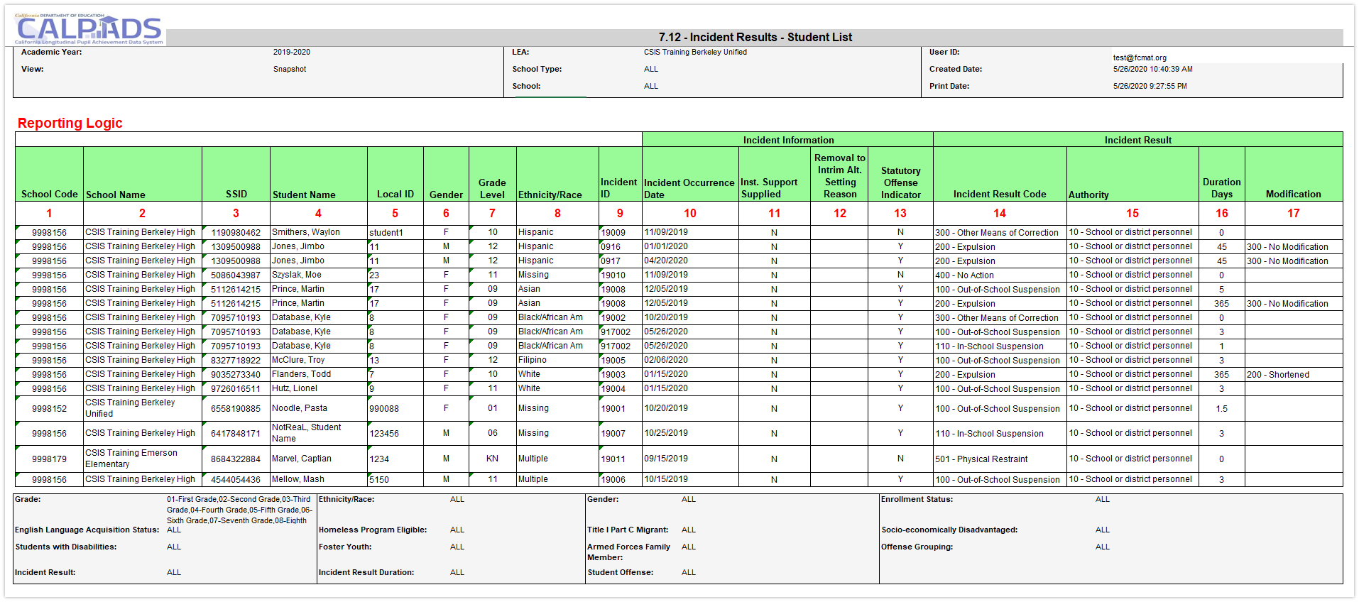
Identify which Report Provides Pertinent Information
Report 7.12 can be used to count individual suspensions and expulsions as well as other results
EOY Primer v1.0 AY 2023-24
Notes:
https://www.cde.ca.gov/nr/el/le/yr21ltr0819.asp
https://www.cde.ca.gov/nr/el/le/yr23ltr0221.asp

Slide 32
Available EOY 3 Training
CALPADS User Manual
Student Absence Summary
Incident
Reclassified EL
Student Program
Student Enrollment
Other Information
Relevant FAQ
CALPADS Update Flash #208 (RFEP)
CALPADS Update Flash #203 (PSTS)
CALPADS Update FLASH #182 (Homeless)
CALPADS Update FLASH #159 (Restrains & seclusion)
NPS Student Incident Guide
Incidents FAQ
STAS FAQ
CSIS YouTube Training Channel
End of Year (EOY) Data Population Trainings
End of Year (EOY) Reporting & Certification Trainings
EOY Primer v1.0 AY 2023-24

Slide 33

EOY 4
Special Education Program, Services, Postsecondary preparation
EOY Primer v1.0 AY 2023-24

Slide 34
EOY 4 Data Collection
SWD Status (SWDS)
Data Submitted Via
Post Secondary Status (PSTS)
SWD Meetings (MEET)
SWD Plan (PLAN)
SWD Services (SERV)*
Data Submitted
Special Education
Postsecondary status
Services
Eligibility/Participation status
SWD Services
Service location
Plans and Program settings
Statutory Meetings
Service provider
Employment and educational status
Site Staff
Staff Involved with Submission
Special Ed staff
Site Administrators
Student System Support Staff
SELPA Directors
Student Families
* Not collected in AY2023-2024
EOY Primer v1.0 AY 2023-24

Slide 35
EOY 4 Pre-snapshot Submission Activities
Record Type | Activity | Reasoning | Processing Method | Record Operational Keys
SWDS, PLAN, MEET | Ongoing | Special Education data is updated as students are tested, meetings are held, records are amended, or eligibility ends. Students' records must be up to date for CAASPP and ELPAC testing | Transaction/ Effective Date | Reporting LEA (District of Service) SSID Reporting SELPA Special Education Meeting Date Student Special Education Meeting or Amendment Identifier Education Plan Type Education Plan Amendment Date
PSTS | Now | Student surveys can be submitted as they are received. The operational key includes the SSID and status code so new records can be submitted with minimal risk to replacing others | Replacement | Academic Year ID Reporting LEA Education Program Participation Type SSID Postsecondary Status Code
EOY Primer v1.0 AY 2023-24

Slide 36

Pain Points SWD PSTS Survey
LEAs are required to report outcomes for SWD who exited secondary education and did not re-enroll
When must data be reported?
For whom must the data be reported?
How many outcomes can be reported for a student?
Can a student be submitted in Fall 2 and EOY 4?
Is there are hierarchy for multiple outcomes?
Are transition students reported?
EOY Primer v1.0 AY 2023-24

Slide 37
EOY 4 Reports
Students with disabilities
Report 16.1
Students with Disabilities - Education Plan By Primary Disability Count (EOY4)
Report 16.3
Students with Disabilities – Profile List (EOY4)
Report 16.2
Students with Disabilities - Count by Federal Setting (EOY4)
Report 16.11
Students with Disabilities – Annual Comparison Report (EOY 4)
Report 16.5
Report 16.6
Students with Disabilities - Student Services by Primary Disability (EOY4)
Students with Disabilities - Student Services Student List (EOY4)
Legend
Aggregate Report
Supporting Report
Report 16.12
Students with Disabilities - Education Plan by Primary Disability (EOY 4)
Report 16.9
Report 16.10
Students with Disabilities Program Exit Count by Primary Disability (EOY4)
Students with Disabilities Program Exit Student List (EOY4)
Report 17.3
Report 17.4
Postsecondary Survey Outcome for SWDs - Count
Postsecondary Survey Outcome for SWDs - Student List
EOY Primer v1.0 AY 2023-24
Notes:
EOY 4 Data Mapping Guides in the user manual -- https://documentation.calpads.org/Reports/SnapshotODSReports/#eoy-1-report-mapping-guides

Slide 38
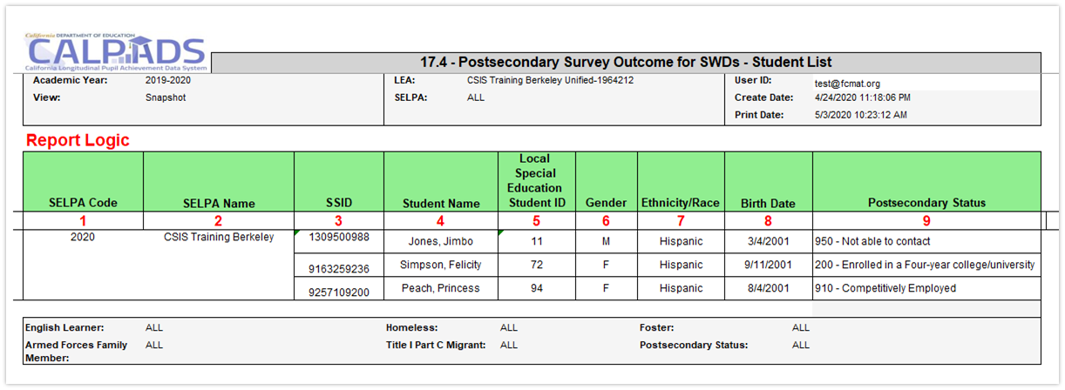
Postsecondary Status Data Analysis
Supporting Report 17.4 will list SWD and their postsecondary outcomes. Detail data is often found in supporting reports, data coordinators should ensure that the proper report is reviewed early in the submission window so there is time to reconcile data
EOY Primer v1.0 AY 2023-24

Slide 39

Available EOY 4 Training
CALPADS User Manual
Students with Disabilities Status (SWDS)
Special Education Plan (PLAN)
Special Education Meetings (MEET)
Special Education Services (SERV)
Postsecondary Status
CDE Guidance
EOY SPED Topics
CALPADS Flash #260 (SPED Redesign)
CALPADS Flash #264 (SPED Updates)
CALPADS Update Flash #203 (SPED PSTS)
CALPADS Update FLASH #161 (General SPED Guidance)
Reporting Data for Students with Disabilities (DSEA Guidance)
CSIS YouTube Training Channel
End of Year (EOY) Data Population Trainings
End of Year (EOY) Reporting & Certification Trainings
EOY Primer v1.0 AY 2023-24

Slide 40

Reminders
Additional CALPADS Activity
EOY Primer v1.0 AY 2023-24

Slide 41

CALPADS Work Continues
Nightly extraction from CALPADS ODS takes 48 hours to show up in TOMS
Updated in CALPADS on . . . | TOMS updated . . .
Thursday | Monday
Friday | Tuesday
Monday | Wednesday
Tuesday | Thursday
Wednesday | Friday
Vacation?
Continue ongoing maintenance of SENR, SINF, SPRG, SELA and SPED
Resolve MID and CCE anomalies to reduce the number of incorrect or missing students from TOMS
Do NOT pre-populate your SENR enrollment exits in CALPADS if students have not completed testing yet. Doing so drops them from the student list for testing.
EOY Primer v1.0 AY 2023-24

Slide 42
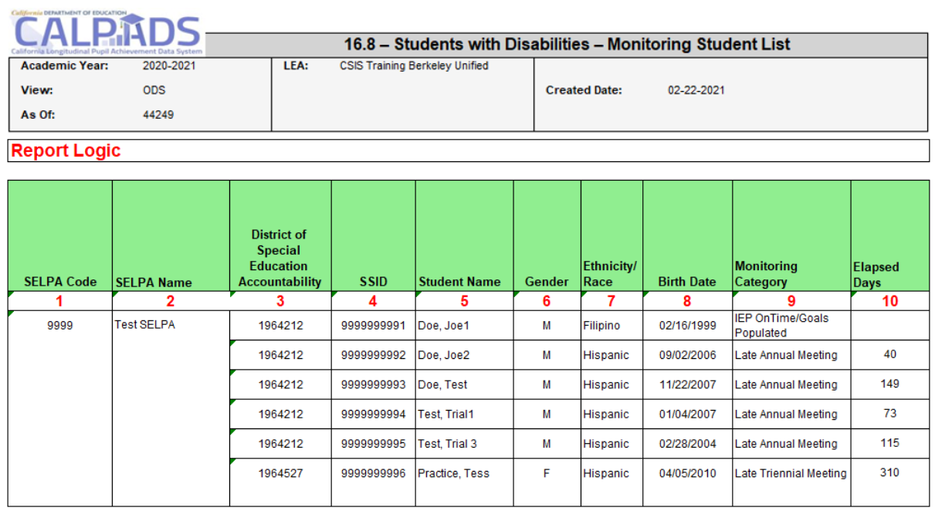
SWD Monitoring
Use monitoring reports to ensure SWD have up to date program information so they can have the appropriate testing accommodations and settings
EOY Primer v1.0 AY 2023-24

Slide 43
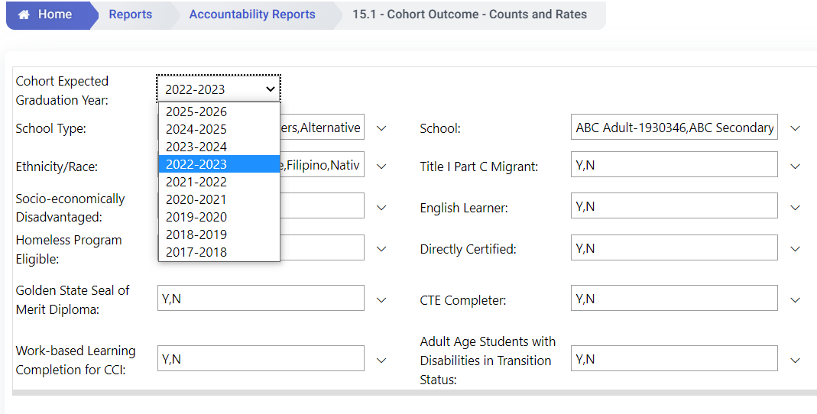
Cohort Reports
4 different cohort years to processing concurrently:
2022-2023
2023-2024
2024-2025
2025-2026
Reminder
Allow a user to select a future cohort year.
  (Report 15.1 and 15.2)
Users can see their cohorts earlier and will be able to verify their first-time 9th grade records sooner.
Will be accessible continuously throughout the whole year
Run the reports to anticipate your candidate list for graduation and anticipate potential dropouts.
Ensuring all cohort members are properly exited from CALPADS.
EOY Primer v1.0 AY 2023-24

Slide 44

Wrap Up
Key Points, Resources and Support
EOY Primer v1.0 AY 2023-24

Slide 45

Summary
Submit Data Now
Understanding the processing method and the operational keys will allow you to submit targeted data and assist in trouble shooting
Early submission of EOY 1 data will allow you to verify completer to pathway mapping
Ensure that schoolwide programs are certified in CARS to overcome the biggest impediment of EOY 2
Submit Data Now
EOY 3 is the single largest data collection yet every file type other than STAS can be submitted in advance of the snapshot running
Approve EOY 4 early so that SELPAs have time to review reports
CALPADS work is constant, data submission is required for testing, cohort and SWD monitoring
CSIS & CDE monitoring whether LEA’s are error free by July 12, so…
Submit Data Now
Some key points to remember
EOY Primer v1.0 AY 2023-24

Slide 46

So, what’s the Key Point?
EOY Primer v1.0 AY 2023-24

Slide 47

Future Training
CALPADS End-of-Year (EOY) training registration is now available in Bridge
EOY Primer v1.0 AY 2023-24

Slide 48




Resources
Here are some important resources related to CALPADS reporting.
  https://learn.fcmat.org/
https://www.youtube.com/channel/UCA9oRTiyVECCCzOxpmJheZw
https://documentation.calpads.org/Support/References
https://www.cde.ca.gov/ds/sp/cl/systemdocs.asp
https://csis.fcmat.org/resources
EOY Primer v1.0 AY 2023-24

Slide 49





Support
http://www2.cde.ca.gov/calpadshelp/default.aspx
Web
calpads-support@cde.ca.gov
Email
916-325-9210
Phone
https://csis.fcmat.org/ListServ
https://www.cde.ca.gov/ds/sp/cl/listservs.asp
You can get help through these channels.
Listserv

Slide 50
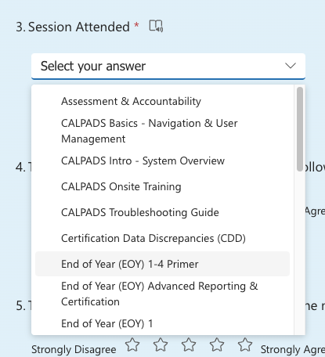
Feedback
I have a question…
“
”
Please complete survey…
https://bit.ly/2MXsECg
“
”
EOY Primer v1.0 AY 2023-24

Slide 51






Thank You
CSIS Training
+1 916 325 9210
csistraining@fcmat.org
https://csis.fcmat.org/

